Slide 1
Job Search
What is it?
Why is it important?
What are the ground roles?

Slide 2
Working, Studying, Business
Adjustability: Language, culture, community, food, weather
Long term prospects: economy, society
Opportunities: growth prospects
Cost of living: safety, legal security, anti-immigration
Financials: education, income, long term
Where does the opportunity rest for you?
Tip: Travelling - hint: scholarships
Research
Speak with people from network
Notes:
Morals
Personal principles of right and wrong.
Shaped by culture, religion, upbringing, or personal beliefs.
Ethics
Systematic rules or standards of right conduct.
Often tied to a professional or social framework (like medical ethics, business ethics, legal ethics).
More external and codified.

Slide 3
Steps to a job/internship
Set up a LinkedIn
Prepare a resume
Search for job
Inbound
Outbound
Advertised positions
Entry tracks
Network (existing) + Networking
etiquettes of networking [keeping updated]
Cover Letter + Resume customize
Preparing for an interview
Notes:
Morals
Personal principles of right and wrong.
Shaped by culture, religion, upbringing, or personal beliefs.
Ethics
Systematic rules or standards of right conduct.
Often tied to a professional or social framework (like medical ethics, business ethics, legal ethics).
More external and codified.

Slide 4
Cover Letter
A cover letter should include the following elements:
Where and how you found out about the position
Your reason for being interested in this company
Your main skills and accomplishments (summary of few key points)
How you fit the requirements for the job
Items of special interest about you that would relate to your potential for the job
Request for an interview
Notes:
Morals
Personal principles of right and wrong.
Shaped by culture, religion, upbringing, or personal beliefs.
Ethics
Systematic rules or standards of right conduct.
Often tied to a professional or social framework (like medical ethics, business ethics, legal ethics).
More external and codified.

Slide 5
Searching for jobs
What kind of job are you looking for?
How much are you targeting to earn?
Where is the location of your next job (Pak/Abroad)?
What are the potential employer names?
Where can you look for such opportunities?
How to use the network?
Notes:
Morals
Personal principles of right and wrong.
Shaped by culture, religion, upbringing, or personal beliefs.
Ethics
Systematic rules or standards of right conduct.
Often tied to a professional or social framework (like medical ethics, business ethics, legal ethics).
More external and codified.

Slide 6
Searching for jobs - I
LinkedIn
24-hours (36000), apply early
Personalized notes to potential managers
Mark ‘companies’ as favourites (notification)
Attend the published events
Network with company employees
Referrals (FAST Network)
Networking events [Talks, Pasha, Software House Association, GameJams, Hackathons, TedX, Global Shapers, Biennale, Faiz Festival]
Existing network [Family/friends, school, university, football, FB, LinkedIn
Notes:
Morals
Personal principles of right and wrong.
Shaped by culture, religion, upbringing, or personal beliefs.
Ethics
Systematic rules or standards of right conduct.
Often tied to a professional or social framework (like medical ethics, business ethics, legal ethics).
More external and codified.

Slide 7
Searching for jobs - II
Career Track programs [set up notifications]
Google Careers
Meta Careers
MNCs in Pakistan
Cool places in Pak (passion focused)
Jack & Jill
Headhunters/recruiters
Upskill/Freelance/stay busy, as you look for opportunities
Notes:
Morals
Personal principles of right and wrong.
Shaped by culture, religion, upbringing, or personal beliefs.
Ethics
Systematic rules or standards of right conduct.
Often tied to a professional or social framework (like medical ethics, business ethics, legal ethics).
More external and codified.

Slide 8
Resume Writing
What is it?
Why is it important?
What are the ground roles?

Slide 9
AI-Optimized Resumes
More applicants are using AI tools (like ChatGPT or AI resume builders) to tailor resumes for each job.
Use of keywords from job descriptions is more strategic — not just random buzzwords.
Ethical Use of AI / Transparency / Validated Skills Assessment
As AI’s use grows, there’s a trend toward being honest about how much you used it (or not) in writing your resume.
Bias in AI screening is increasing; some research points to fairness issues in resume evaluation.
More companies are using skills tests or assessments to validate what a resume claims, rather than relying solely on the document
Involvement of AI
Tailored Applications for Every Job
One-size-fits-all resumes are being replaced by versions tailored to each role: different summaries, different highlighted skills.
This improves relevance and helps beat AI screening.
Notes:
Morals
Personal principles of right and wrong.
Shaped by culture, religion, upbringing, or personal beliefs.
Ethics
Systematic rules or standards of right conduct.
Often tied to a professional or social framework (like medical ethics, business ethics, legal ethics).
More external and codified.

Slide 10
Personal Branding
Hiring managers expect a consistent professional brand: LinkedIn profile, resume, maybe even a personal website or portfolio.
More people are including a short summary or “brand statement” about who they are and what they stand for.
Clean, Minimalist, and Mobile-Friendly Design
Modern layouts lean toward minimalism: simple headings, lots of white space, clean fonts.
But some visual “flair” is coming back: subtle color accents, infographics for skills, icons — especially in creative fields.
Resumes are being optimized for mobile reading too.
On the format
Interactive or Multimedia Elements
For creative or digital roles: video resumes, interactive portfolios, or QR codes linking to projects are on the rise.
But note: too much design or exotic formatting can trip up ATS (Applicant Tracking Systems).
Notes:
Morals
Personal principles of right and wrong.
Shaped by culture, religion, upbringing, or personal beliefs.
Ethics
Systematic rules or standards of right conduct.
Often tied to a professional or social framework (like medical ethics, business ethics, legal ethics).
More external and codified.

Slide 11
Quantified and Impactful Achievements
Results over responsibilities: recruiters want “increased sales by 20%” or “reduced costs by $X” more than general job duties.
This makes your impact concrete and easy to assess.
Continuous Learning & Micro-Credentials
Including up-to-date certifications, online courses (Coursera, Udemy, etc.), and micro-credentials is more common.
This signals a growth mindset and adaptability
Must include
Remote/Hybrid/Soft Skills: Cultural fit and work adaptability
Given the rise of remote/hybrid work, highlighting experience with virtual collaboration tools (Zoom, Slack, Teams) is more valuable.
Also important: showing you can work independently, manage time, and communicate virtually.
Soft skills (communication, adaptability, leadership) are being showcased more — not just technical know-how
Employers are looking for people who not only can do the job but fit culturally.
Notes:
Morals
Personal principles of right and wrong.
Shaped by culture, religion, upbringing, or personal beliefs.
Ethics
Systematic rules or standards of right conduct.
Often tied to a professional or social framework (like medical ethics, business ethics, legal ethics).
More external and codified.

Slide 12
While writing Resumes
Use a clean, ATS-friendly layout.
Lead with skills + achievements, not just job titles.
Quantify your impact.
Include soft + digital/remote skills.
Link to a professional online presence (LinkedIn, portfolio).
Be intentional with tailoring — use AI or manual editing to match job descriptions.
Show continuous learning (certifications, courses).
If relevant, use multimedia carefully — but don’t break ATS.
Don’t hide your use of AI — but also don’t rely on it entirely.
Notes:
Morals
Personal principles of right and wrong.
Shaped by culture, religion, upbringing, or personal beliefs.
Ethics
Systematic rules or standards of right conduct.
Often tied to a professional or social framework (like medical ethics, business ethics, legal ethics).
More external and codified.

Slide 13
Types of Resumes
Chronological Structure (Most common)
Functional Structure (Skills-first)
Project-Based Structure
Academic / Research Structure
5. Combination / Hybrid Structure (Most popular)
Notes:
Morals
Personal principles of right and wrong.
Shaped by culture, religion, upbringing, or personal beliefs.
Ethics
Systematic rules or standards of right conduct.
Often tied to a professional or social framework (like medical ethics, business ethics, legal ethics).
More external and codified.

Slide 14
Types of Resumes
Chronological Structure (Most common)
Functional Structure (Skills-first)
Project-Based Structure
Academic / Research Structure
5. Combination / Hybrid Structure
Notes:
Morals
Personal principles of right and wrong.
Shaped by culture, religion, upbringing, or personal beliefs.
Ethics
Systematic rules or standards of right conduct.
Often tied to a professional or social framework (like medical ethics, business ethics, legal ethics).
More external and codified.

Slide 15
Resume components
best for Tech / Engg / DS/ Fresh
Header
Profile Summary
Education
Key Projects (4–6 projects) [Project | Tools | Result]
What you built
What problem you solved
Any measurable outcome
Experience (Internships or part-time)
Keep short (2–3 bullets per role)
Core Skills (Split into)
Technical
Tools
Soft skills
Certifications
Notes:
Morals
Personal principles of right and wrong.
Shaped by culture, religion, upbringing, or personal beliefs.
Ethics
Systematic rules or standards of right conduct.
Often tied to a professional or social framework (like medical ethics, business ethics, legal ethics).
More external and codified.

Slide 16
LinkedIn Profiles
What is it?
Why is it important?
What are the ground roles?

Slide 17
Linkedin profile essentials
Choose the right profile picture for LinkedIn
The picture should be recent and should looks like you
Your face should take up around 60% of it (long-distance shots don’t stand out),
Wear what you would like to wear to work,
Smile with your eyes!
Make your headline more than just a job title
Turn your About section into your story
Your About section is your chance to tell more about yourself. You can write upto 400 words. Ideally there should be at least ~250
Notes:
https://www.linkedin.com/business/talent/blog/product-tips/tips-for-taking-professional-linkedin-profile-pictures

Slide 18
Linkedin profile essentials
Share experience (internships), volunteer work
Share projects, publications
Showcase your credentials (languages, certifications, license)
Request recommendations
Notes:
https://www.linkedin.com/business/talent/blog/product-tips/tips-for-taking-professional-linkedin-profile-pictures

Slide 19
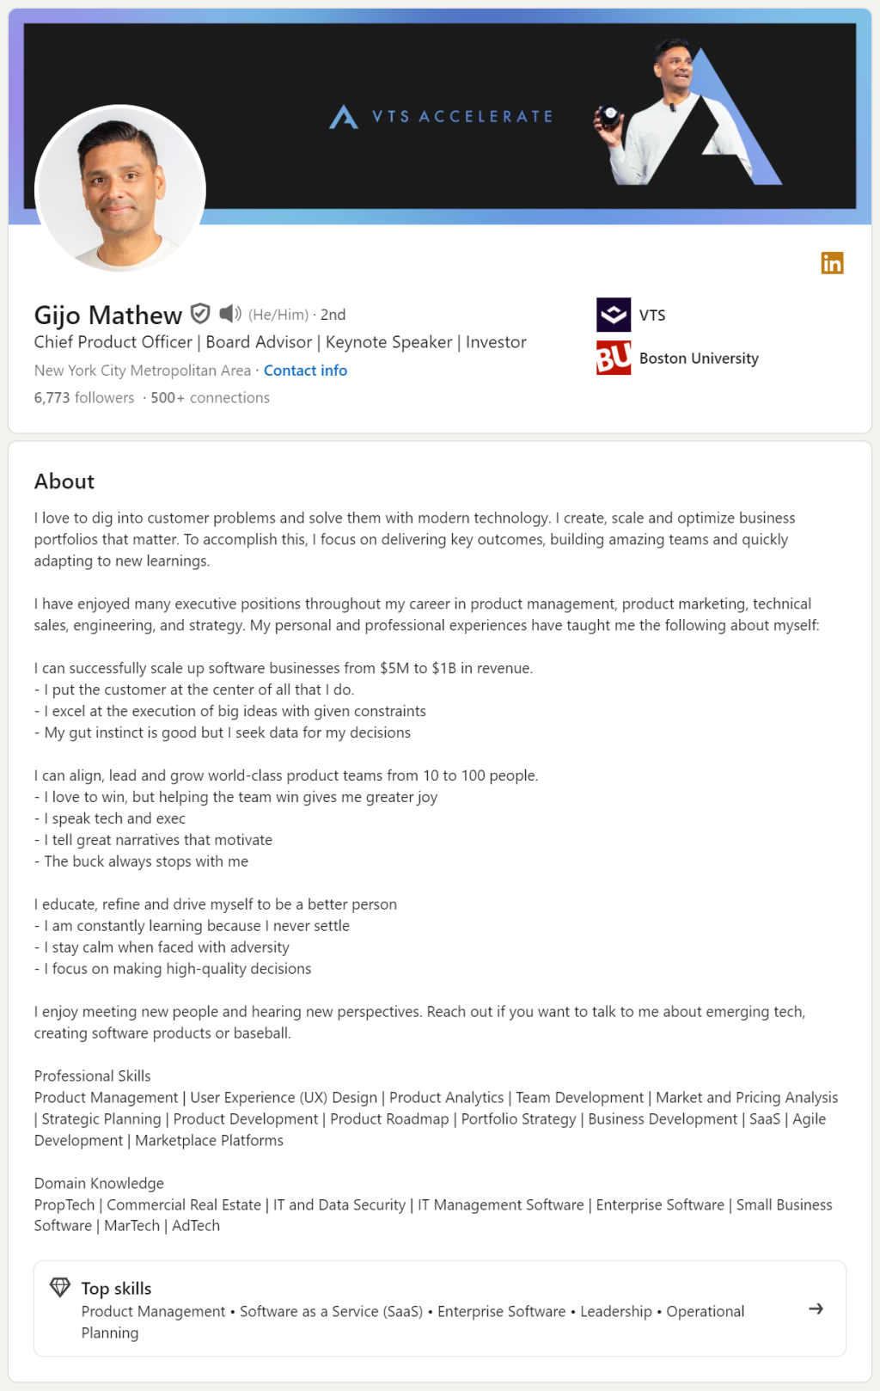

Slide 20
Formal Reports
In comparison to informal documents, formal documents usually:
cover more complicated projects
are longer than their informal counterparts
have a more diverse set of readers
Notes:
Readers who want just a quick overview can turn to the executive summary at the beginning or the conclusions and recommendations at the end; technical readers who want to check your facts and figures can turn to discussion sections or appendixes; and all readers can flip to the table of contents for a quick outline of what sections the document contains.

Slide 21
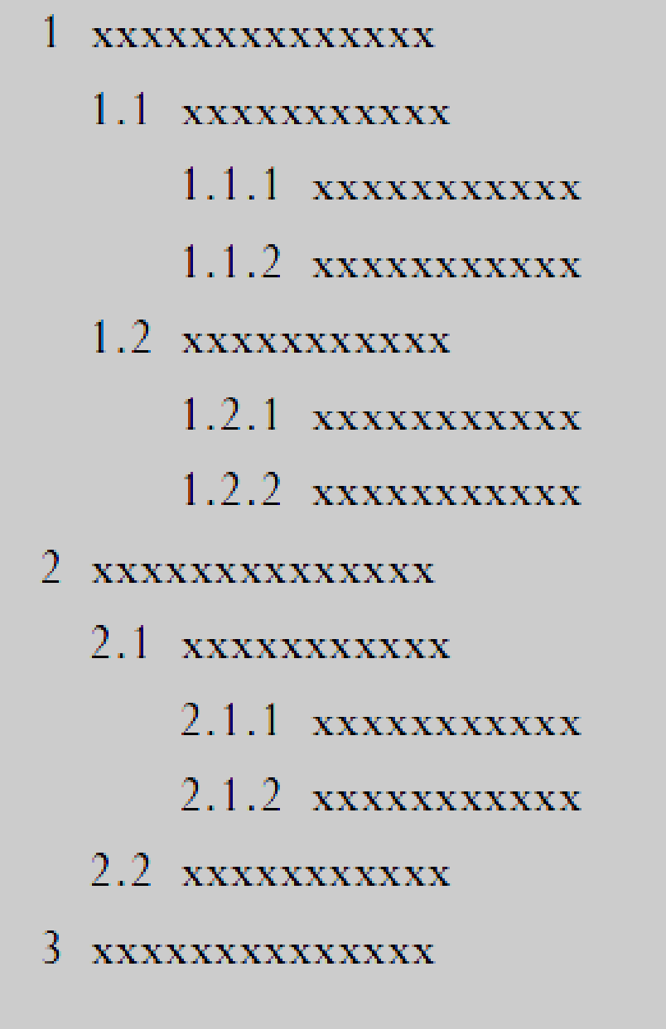
Headings Decimal
FIRST-LEVEL HEADING
(all caps, bold, on a line by itself)
Second-level heading
(initial cap only, bold, on a line by itself)
Third-Level heading
(initial cap only, bold, followed by two spaces, as part of the first line of the paragraph)

Slide 22
Parts of a Formal Reports [FYP]

Slide 23
1. Cover/title page
2. Letter or memo of transmittal
3. Table of contents
4. List of illustrations
5. Executive summary
6. Introduction
7. Discussion sections
8. Conclusions and recommendations
9. End material
Notes:
The parts of formal documents are as follows

Slide 24
Formal Report | FYP
Cover/title page Letter or memo of transmittal Table of contents List of illustrations Executive summary Introduction Discussion sections Conclusions and recommendations End material | Title Page Undertaking Table of contents List of Tables List of Figures Abstract Introduction (Chapter-1) Literature Review (Chapter-2) Requirements and Design (Chapter: 3) Implementation and Test Scores (Chapter: 4) Results and Analysis (Chapter: -5) Conclusions (Chapter-6) References Appendix
Notes:
We can match the basic sections of the formal report with sections or chapters of FYP (Final Year Rport) that you will be working on

Slide 25
Cover letter / Title Page
1.
Cover letter should include key information such as what is the report? who is it for? who is it by? what is time frame? etc.
Should include:
Project title
For who: Your client’s or recipient’s name (“Prepared for . . .”)
Your name and/or the name of your organization (“Prepared by . . .”)
Date of submission

Slide 26
Letter or memo of transmittal
2.
Include a major point from the report (Why you are writing/ What exactly of importance is within it, what value it brings.
Should come immediately after the title page
Follow letter and memo conventions (e.g. single-spacing; use only one page)

Slide 27
Table of contents
3.
An effective table of contents fleshes out the details, so your readers know exactly what is covered in each section – saves their time and helps them find the information they want and need.
It acts as an outline
It should be a complete and accurate listing of the main and minor topics covered in the report.
You don’t want just a brief and sketchy outline of major headings.

Slide 28
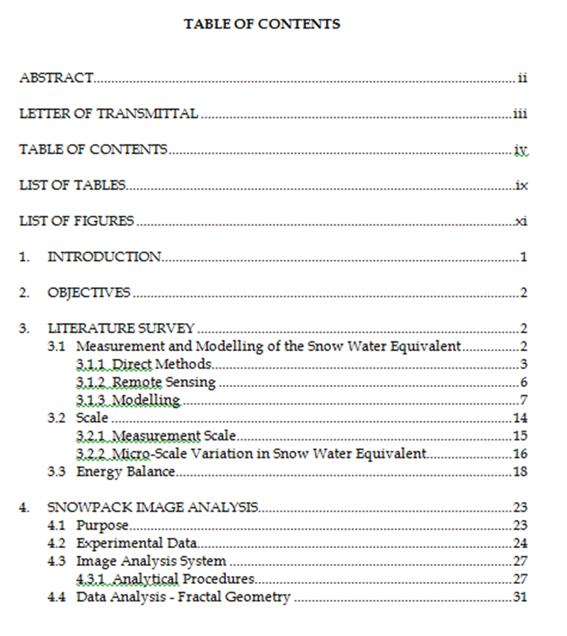

Slide 29
List of illustrations
4.
If your report contains several tables and figures, you will need to provide a list of illustrations.
This list can be included below your table of contents, if there is room on the page, or on a separate page.
As with the table of contents, your list of illustrations must be clear and informative.

Slide 30
Table of contents
3.
An effective table of contents fleshes out the details, so your readers know exactly what is covered in each section – saves their time and helps them find the information they want and need.
It acts as an outline
It should be a complete and accurate listing of the main and minor topics covered in the report.
You don’t want just a brief and sketchy outline of major headings.

Slide 31
Executive summary / Abstract
5.
The abstract is a brief overview of the report’s key points geared towards a varied audience from a low-tech reader to managers, supervisors, and highly placed executives.
They need your help in two ways:
They need information quickly
They need it presented in an understandable terminology
You can achieve both these objectives through an abstract or executive summary.

Slide 32
Introduction
6.
Introduction welcomes the readers and tells them what to expect, it is not a summary but a opening
Give information on, the report’s:
Purpose: State your purpose, as the first part of the introduction
Scope: detail and description of your project should be written clearly
Format: a brief preview of the main sections that follow

Slide 33
Body | Discussion sections
7.
This will be the body of your report and respond to the objective.

Slide 34
Conclusions [and recommendations, if any]
8.
Based on findings of the report, a closing should be composed outlining the key takeaways for the readers.
Discuss results based on findings of your study.
Recommendations are actions suggested on the basis of your conclusion.
Should provide the readers with a sense of closure

Slide 35
End Material - References
The two parts to referencing are:
citations in the text of the report
a list of references in the final section
A citation shows that information comes from another source. The reference list gives the details of these sources.
You need to use in-text citations and provide details in the references section when:
you incorporate information from other sources; e.g.:
factual material
graphs and tables of data
pictures and diagrams
9.

Slide 36
End Material - Appendix
9.
Appendix allows to include any additional information (surveys, results, tables, figures, previous report findings, relevant letters or memos, etc.) that you have not built in your report’s main text.
It is optional
The contents of your appendix should not be of primary importance, which needs to be the part of the body of the report.
An appendix is a perfect place to file nonessential data that provides documentation for future reference.

Slide 37
Technical Communication in the Workplace

Slide 38
Research Introduction
Topic
Research Objectives
Topic selection
Defining a topic
Identifying resources
What is the quest? the learning outcomes?
Listing them clearly
Focus on the problem understanding
Unbiased and neutral

Slide 39
Before starting your research, you ask yourself the following questions, to give direction to your work:
What questions must be answered during the research phase?
What information might be most useful?
What print and electronic sources would be most appropriate?
What format must be used to document material borrowed from sources?

Slide 40
Secondary Research
Topic
Research Objectives
Secondary Research
Authenticity
Credibility
Relevance
Scope
Topic selection
Defining a topic
Identifying resources
What is the quest? the learning outcomes?
Listing them clearly
Focus on the problem understanding
Unbiased and neutral
Review of the existing literature, information.
Being curious. Ignoring existing research can point to arrogance.
Books
Journals
Research papers
Documentaries
Podcasts

Slide 41
Respondent’s profile
Topic
Research Objectives
Secondary Research
Target Audience
Topic selection
Defining a topic
Identifying resources
What is the quest? the learning outcomes?
Listing them clearly
Focus on the problem understanding
Unbiased and neutral
Review of the existing literature, information.
Being curious. Ignoring existing research can point to arrogance.
Respondent profiles
Who is my right audience?

Slide 42
Primary Research
Interviews
Focus groups
Surveys/Questionnaires
Laboratory experiments, or field observations
Original works such as diaries, company reports, and correspondence, as well as documents that are the subject of analysis, such as user’s manuals and Web sites.
Qualitative
Quantitative

Slide 43
Quantitative
Qualitative
Quantifyable data that can be analyzed
Quantitative research collects data that can be represented in numbers.
Qualitative research analyzes words, images, processes, or objects
Information observed through conversations, (field) observations, anecdotal evidence

Slide 44
Designing a questionnaire I
Introduction
Filter question
Guidelines
Sequence, skips
Classification (target audience)
Close
Validity; it measures what it was designed to measure.
Reliability; it can be repeated with the same results.
Notes:
Morals
Personal principles of right and wrong.
Shaped by culture, religion, upbringing, or personal beliefs.
Ethics
Systematic rules or standards of right conduct.
Often tied to a professional or social framework (like medical ethics, business ethics, legal ethics).
More external and codified.

Slide 45
Designing a questionnaire II
Using Questionnaire and Interviews:
Keeping reader’s need while preparing the questionnaire
It benefits them personally or professionally/it is easy to fill out and return
Write a precise purpose statement
E.g. “The purpose of this survey is to find out ways in which…..”
Limit the number of questions
Every question must serve the purpose/ resist the temptation to clutter questionnaire with irrelevant questions
Ask mostly objective questions
So that the questions are easy to answer and responses are easy to compile
Notes:
Morals
Personal principles of right and wrong.
Shaped by culture, religion, upbringing, or personal beliefs.
Ethics
Systematic rules or standards of right conduct.
Often tied to a professional or social framework (like medical ethics, business ethics, legal ethics).
More external and codified.

Slide 46
Designing a questionnaire III
Types of Questions | Examples
Either/Or Questions | Would you or your technical staff find it useful to receive a technical newsletter on acid rain? Yes No
Multiple Choice Questions | If you answered “yes” to preceding question, what publication schedule would best meet your needs: Monthly Quarterly yearly
Grade-Scale Questions
Short-Answer Questions | List any environmental newsletters you already receive that you find helpful in business.
I find it very easy to start conversations with strangers
Strongly Agree | Agree | Disagree | Strongly Disagree

Slide 47
Designing a questionnaire IV
Provide clear questions that are easy to answer:
Avoid four common problems:
Biased in phrasing
Use of undefined terms
Use of more than one variable
Questions that require too much homework
Include precise and concise instructions at the top of the form
Test the questionnaire on a sample audience (Pilot)
Notes:
Morals
Personal principles of right and wrong.
Shaped by culture, religion, upbringing, or personal beliefs.
Ethics
Systematic rules or standards of right conduct.
Often tied to a professional or social framework (like medical ethics, business ethics, legal ethics).
More external and codified.

Slide 48
Format
Date
Address
Subject Line
Salutation
Body
Regards
Your name
Contact Information
Information presented differently in memo, letter and email.
Objective
Dear / Respected / Hi
Abstract/ Opening
Boday
Closing
Reason/Purpose explained
Reasons/Evidence
Call to action/Closing/Summary
Courteous close and sender details

Slide 49
Technical Communication in the Workplace

Slide 50
Correspondence Guideline 1: Know Your Purpose
Before beginning → write down your purpose in one clear sentence.

Slide 51
What is the purpose in below correspondence:
“As you requested yesterday, I am sending samples of the new candy brands you are considering placing in M-Global’s office vending machines.”

Slide 52
What is the purpose in below correspondence:
“As you requested yesterday, I am sending samples of the new candy brands you are considering placing in M-Global’s office vending machines.”
Purpose

Slide 53
What is the purpose in below correspondence:
This letter explains M-Global’s new policy for selecting rental cars on business trips.

Slide 54
What is the purpose in below correspondence:
This letter explains M-Global’s new policy for selecting rental cars on business trips.

Slide 55
What is the purpose in below correspondence:
I have attached the most recent draft of the proposal for the PI Corp. pipeline project.

Slide 56
What is the purpose in below correspondence:
I have attached the most recent draft of the proposal for the PI Corp. pipeline project.
Purpose: Implied?

Slide 57
Correspondence Guideline 1: Know Your Purpose
Before beginning → write down your purpose in one clear sentence.
Correspondence Guideline 2: Know Your Reader
Who are you trying to inform or influence? Affects the vocabulary you choose, the arguments you make, and the tone you adopt.

Slide 58
What is the purpose in below correspondence:
Who are you trying to inform or influence?
“As you requested yesterday, I am sending samples of the new candy brands you are considering placing in M-Global’s office vending machines.”
Tone?
Wording?
Audience?

Slide 59
What is the purpose in below correspondence:
Who are you trying to inform or influence?
“As you requested yesterday, I am sending samples of the new candy brands you are considering placing in M-Global’s office vending machines.”
Professor / Manager
Tone? Respectful, Formal
Wording? Formal, Proper
Audience? Senior

Slide 60
What is the purpose in below correspondence:
Who are you trying to inform or influence?
This letter explains M-Global’s new policy for selecting rental cars on business trips.
Tone?
Wording?
Audience?

Slide 61
What is the purpose in below correspondence:
Who are you trying to inform or influence?
This letter explains M-Global’s new policy for selecting rental cars on business trips.
Internal company staff
Tone? Informative, Professional
Wording? Proper, Formal
Audience? Known, Group

Slide 62
What is the purpose in below correspondence:
Who are you trying to inform or influence?
I have attached the most recent draft of the proposal for the PI Corp. pipeline project.
Tone?
Wording?
Audience?

Slide 63
What is the purpose in below correspondence:
Who are you trying to inform or influence?
I have attached the most recent draft of the proposal for the PI Corp. pipeline project.
Email b/w colleagues
Tone? Conversational
Wording? Less formal
Audience? Known, Individual

Slide 64
Correspondence Guideline 1: Know Your Purpose
Before beginning → write down your purpose in one clear sentence.
Correspondence Guideline 2: Know Your Reader
Who are you trying to inform or influence? Affects the vocabulary you choose, the arguments you make, and the tone you adopt.
Correspondence Guideline 3: Follow Correct Format
Correspondence Guideline 4: Follow the ABC Format for All Correspondence
Organizing correspondence: Abstract (Objective) → Body (Content) → Conclusion (Summary)
Correspondence Guideline 5: Use the 3Cs Strategy
Capture (Ask/Reason/Hook) → Convince (support/action) → Contact (Way-forward)

Slide 65
Correspondence Guideline 6: Stress the “You” Attitude
From your reader’s perspective: What will interest my reader?” and “What does my reader want to accomplish?”
Correspondence Guideline 7: Use Attachments for Details
Correspondence Guideline 8: Be Diplomatic Authentic & Respectful
Correspondence Guideline 9: Edit Carefully
Review: Does it convey the message? Spell check, grammar, sentence structure etc.
Correspondence Guideline 10: Respond Quickly

Slide 66
Types of Messages
Neutral, Routine, Positive, Good will messages
Bad news, Negative messages
Persuasive messages

Slide 67
Types of Messages
Neutral, Routine, Positive, Good will messages
■ Letter replying to a question about products or services
■ Letter responding favorably to a complaint or an adjustment
■ Letter hiring an employee
■ Announcing high bonuses for the year
■ Commending an employee for performance on a project
■ Requesting information about a product or service
■ Inviting the reader to an event
■ Summarizing the results of a meeting with a client
■ Explaining a new laboratory procedure

Slide 68
Types of Messages
Bad news, Negative messages
■ Explaining delays in projects or delivery of services
■ Letter refusing to make adjustments based on complaints
■ Letter giving bad news about employment or performance
■ Reporting decreased quarterly revenues for the year
■ Requesting closer attention to filling out timesheets
■ Email asking for volunteers to work on a holiday

Slide 69
Types of Messages
Persuasive messages
■ Starting a business relationship
■ Registering complaints about products or services
■ Letter seeking repeat business (Sales)
■ Requesting funding for a training seminar
■ Explaining policy changes that may be perceived negatively
■ Encouraging employees to follow required procedures

Slide 70
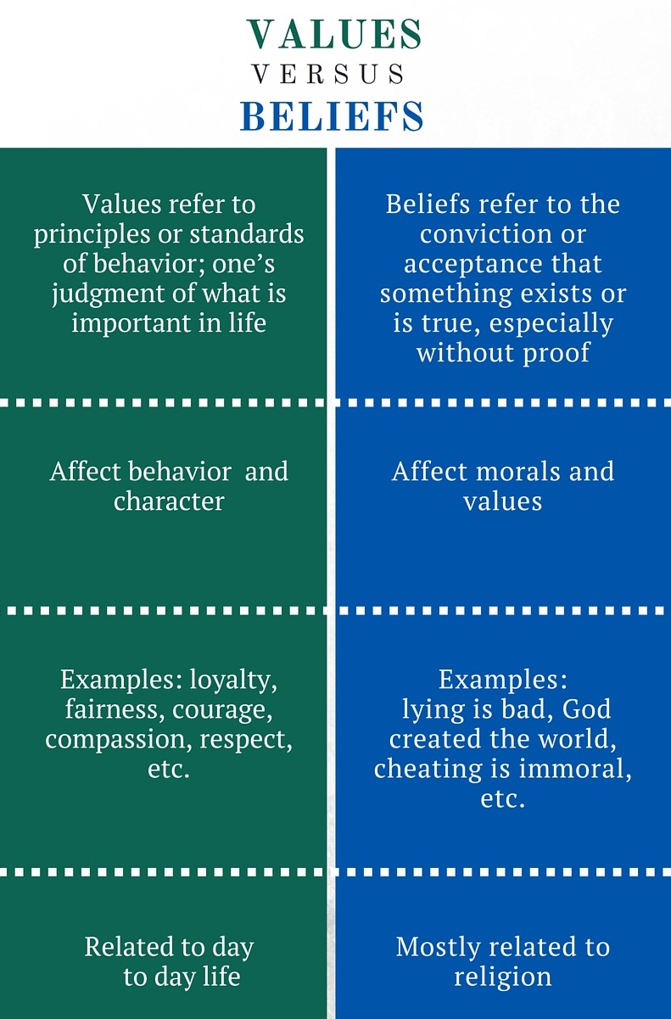
Organizational culture
refers to a
system of shared meaning
that includes
values, beliefs, and assumptions that characterize the organization
Values of companies - examples? Nike, Coke, FAANG, SpaceX
Assignment: Look up the values of the company you dream to work for or take inspiration from for your company.

Slide 71
Understanding Cultures
All cultures have both common features and distinctive differences that must be studied. People in different cultures have different ways of thinking, different ways of acting and different expectations in communication.
One of the ways to study cultural differences is through the concepts of high-context cultures and low-context cultures.

Slide 72
High-Context Cultures
High-context cultures are fairly homogeneous, with the culture providing a high degree of context for communication. Thus, communications may be less explicit because members of the culture share characteristics such as religion, ethnic background, and education. Japan is an example of high-context culture.
Important characteristics of high-context cultures include:
Community based; difference between insiders and outsiders
A focus on maintaining relationships, on saving face, and on helping others save face
A dependence on internalized cultural norms to govern behavior.

Slide 73
Low-Context Cultures
Low-context cultures consist of diverse religions, ethnic backgrounds, and educational levels; as a result, communication must be explicit, because members of a group cannot assume that they share knowledge or attitudes. The culture provides a low degree of context for communication. The United States is an example of a low-context culture.
Important characteristics that affect communication in low-context cultures include
More individualistic, easier to enter
A focus on actions and solving problems, with a willingness to disagree openly
A dependence on formally established rules to govern behavior

Slide 74
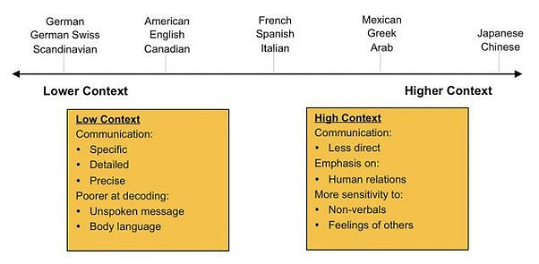

Slide 76

The concept of low-context and high-context cultures offers a general way of thinking about how to relate to clients and colleagues in other cultures and countries, but if you find yourself working in a global, intercultural setting, you should understand the specific cultural practices of those you are working with.

Slide 77
Guidelines for Communicating Internationally
Simplify grammar and style rules
Use simple verb tenses and verb constructions.
Limit vocabulary to words with clear meanings.
Use language and terminology consistently; per meaning.
Define technical terms.
Avoid slang terms and idioms.
Include visuals. Graphics are
Notes:
Following are some basic guidelines to reduce the risk of misunderstanding:
When writing documents for other cultures, remember that your work will not be read in the cultural context in which it was written.
For that matter, you may lose control of the document altogether if it is translated into a language that you do not know.

Slide 78
Case Study: Intercultural Communication in a Global Business Environment
GlobalTech Solutions (GTS) is a multinational technology company headquartered in the United States, with offices in Europe, Asia, and South America. The company specializes in software development, IT consulting, and digital transformation services. GTS recently acquired a smaller tech firm, TechInnovate, based in Pakistan, to expand its market presence in Asia. As part of the acquisition, GTS plans to integrate TechInnovate’s employees into its global operations. This integration involves a series of virtual meetings, cross-cultural training sessions, and collaborative projects between teams in the U.S. and Pakistan.
In the first virtual meeting between the U.S. and Pakistani teams, several communication issues arise. The American team notices that their Pakistani counterparts are unusually quiet during discussions. They rarely voice their opinions or disagree with any points made. Meanwhile, the Pakistani team feels that the American team is overly direct and somewhat aggressive in their approach, which makes them uncomfortable.
Notes:
Discuss in pairs and present answers to the class.

Slide 79
Key Players:
John Davis: Project Manager from the U.S. team, known for his direct communication style.
Saba Ali: Senior Developer from the Pakistani team, values harmony and prefers a consensus-driven approach.
Sarah Lee: HR Manager at GTS, responsible for overseeing the integration process.
Aslam Khan : HR Manager at TechInnovate, tasked with supporting the transition.

Slide 80
Questions:
Question 1: What are the key cultural differences in communication styles between the U.S. and Pakistani teams?
Question 2: How can GTS facilitate better communication between the teams?
Question 3:What strategies can John and Saba use to improve their collaboration?
Question 4: How can the HR managers, Sarah and Aslam, support a smoother integration process?

Slide 81
Cultural Differences: P. 10
Big picture vs. details | High-context vs. Low-context
Order vs. chaos | Monochronic vs. Polychronic
Formal vs. informal | Top-down communication vs. back and forth and up and down
Motivations and rewards | Personal achievement vs. financial rewards
Quality vs. quantity of decisions | methodical process
Giving and receiving feedback | Negative vs. positive feedback
Expressing opinions | Openly disagree
Role of managers | Egalitarianism vs. hierarchy
Willingness to sacrifice personal time | forgo personal time if needed.

Slide 82
Task:
Based on these variations in culture (P:10), select any two countries and compare these elements
Talk about at least 5 differences or similarities
Examples could be in form of images, videos or case studies
Submit a write up (350 words)

Slide 83
“Ethics is the discipline concerned with what is morally good and bad, right and wrong.”
Encyclopedia Britannica

Slide 84
Ethical behavior enables employees to act with equity, fairness, impartiality and respect for the rights of others.
Ethical business communicators make choices that enable them to:
Follow the organization's policies, procedures, guidelines and code of ethics
Communicate factual information objectively
Avoid using distortions of fact and misleading information
Respect the dignity of each person, irrespective of ethnic background, religion or gender

Slide 85
“Our product is just what you need”
“Our artificial sweetener is composed of proteins that occur naturally in the human body [amino acids].”
“Our Krunchy Cookies contain no cholesterol”
Such claims are technically accurate but misleading.
Amino acids in certain sweeteners can alter body chemistry and cause headaches, seizures and possible brain tumors
Processed food snacks often contain saturated fat and trans fats, from which liver produces cholesterol
In addition to being informative and persuasive, communicators must be ethical.
Notes:
Arguments can WIN without being ethical if they WIN at any cost

Slide 86
Ethics Guidelines
Tips
Be honest
Do no harm
Be fair
Honor intellectual property rights
Respect confidentiality
Be professional
Acknowledge sources for information other than Common Knowledge
Seek written permission before borrowing extensive text
Seek written permission before borrowing graphics
Seek Legal advice when you cannot resolve complex questions

Slide 87
Ethical Issues | Meaning | Examples
Suppression of Information | Burying to data to hide inconvenient truths | A company fails to reveal product-testing results that indicate potential danger to consumers
Falsification or fabrication | Changing or inventing data to support a desired outcome | A company boasts of a fictitious enterprise to lure investors into supporting a new venture
Overstatement or understatement | Exaggerating the positive aspects of a situation of downplaying negative aspects to create the desired impression | A public-opinion survey describes 55 percent of the respondents as a “substantial majority” and 45 percent as “a small percentage”
Selective misquoting | Deleting words from quoted material to distort meaning | A supervisor changes a report’s conclusion that “this proposal will seem feasible only to workers unfamiliar with the situation” to “this proposal will seem feasible.. to workers”
Subjective Wording | Using terms deliberately chosen for their ambiguity | A company advertises “customary service charges”, knowing that “customary” is open to broad interpretation.
Conflict of interest | Exploiting behind-the-scenes connections to influence decision-making | A board member of a community agency encourages the agency to hire her company for paid services rather than soliciting bids
Withholding information | Refusing to share relevant data with coworkers | A computer-savvy employee provides misleading answers about new software to make recently hired coworker appear incompetent
Plagiarism | Taking credit for someone else’s ideas, findings | An employee assigned to prepare a report written by someone at another company, downloaded from internet
Notes:
,

Slide 88
Salam & Bienvenue* TBW Fall 2025 Class!
About you
About me
About the course
Class rules
How should we best the make use of our time together?
*Welcome in French

Slide 89
Some rules to control the fun
Lets respect everyone’s time
Attendance - university’s 80% presence class rule (your responsibility)
Weightage and performance
Class participation
‘GPA: a measure of intelligence? Who would you hire someone reliable or hit-or-miss?
No cross talking please - allow everyone to speak
Say your name before you speak (until needed)
Clean up. Respect the education you are paying for.
Slides - may be? I will think about it. Read the book.
Class rep
Email addresses – google group

Slide 90
Your introduction
What do I know about
you? Or have heard
about you
What do you want to
tell me about yourself?
surprise me I’ve heard too much of I’d to and the course seemed easy AND I had to)
Curious to know what role social media has on today’s young generation?
What do you want to be? Who you are? Do you recognize the privilege you have? What excites you?
Gen Z.
Have little interest in extracurricular

Slide 91
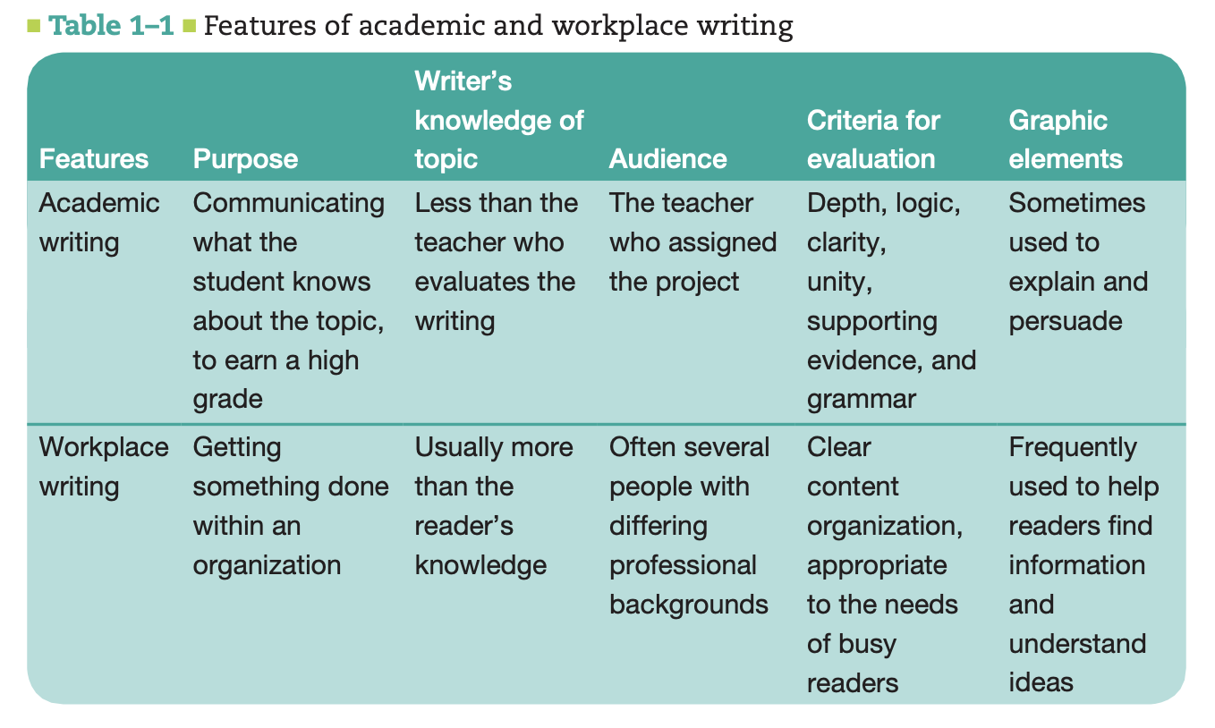

Slide 92
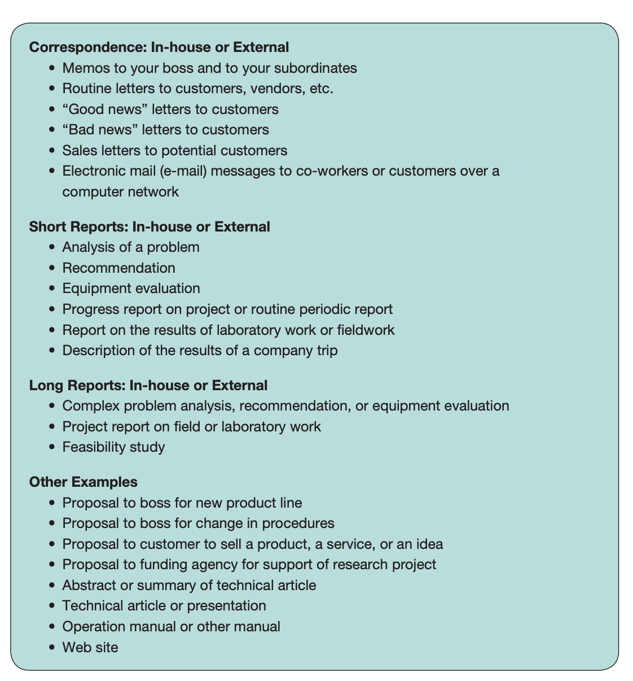

Slide 93
Business Climate
The economic and political factors that influence an organization’s priorities, plans, and activities.
These factors include competition, investor interests, regulations, and the overall health of the economy.
Two practices that are being used more often in the global business climate are outsourcing and offshoring…
Notes:
An organization’s culture is not isolated from the cultures of other organizations, or from the wider culture or cultures in which it is located. Organizations, especially businesses and corporations such as M-Global, must respond to the business climate. To compete in today’s global business climate, companies are focusing on quality and efficiency.

Slide 94
Outsourcing
the practice of purchasing goods or subcontracting services from an outside company. Both the client company and the company that is providing the goods or services may be in the same country, or they may be in different countries.
Offshoring
Happens when a company moves some of its operations to another country. This practice is often done to reduce labor costs, but it may also help a company work more efficiently by creating offices closer to suppliers or clients
Notes:
Although both practices are changing the workplace, they also offer opportunities for companies and employees who are prepared for the global marketplace.

Slide 95
Globalization
A process in which → worldwide integration and interdependence is promoted across borders
Driving factors: Telecommunication, internet + Transport, infrastructure
Is that true for Pak? Where are we in the process of globalization? What disadvantages/advantages does it present? Comparison to the Neighbour, Middle east, NA, Europe?

Slide 96
Diversity
Globalization has resulted in increased diversity at workplaces
How does diversity help? (Some: talent attraction, better service audience needs, shareholder values, profits)
Diversity is good, hence we should learn to be inclusive
We need to stress that all human cultures have common needs, a common sense of humanity.
But there are differences, too. How in the world do you please a customer, for example, if
you don’t know what he or she values? That’s what culture is all about, that’s what
differences are all about. Diversity assumes not only that people are different—we know
that—but that their difference is value-added. If you know how to harness that difference,
you’ll be more competitive as a corporation than those firms that don’t, whether in the
domestic marketplace, and certainly in the global marketplace.37
Inclusion

Slide 97
Elements of Organization Culture
Organization History
Type of Business
Management Style
Notes:
An organization’s culture is influenced by the firm’s history, type of business, management style,
values, attitude toward customers, and attitude toward its own employees. Taken together, all features of a particular organization’s culture create a definable quality of life within the working world of that organization.

Slide 98
